Slide 1
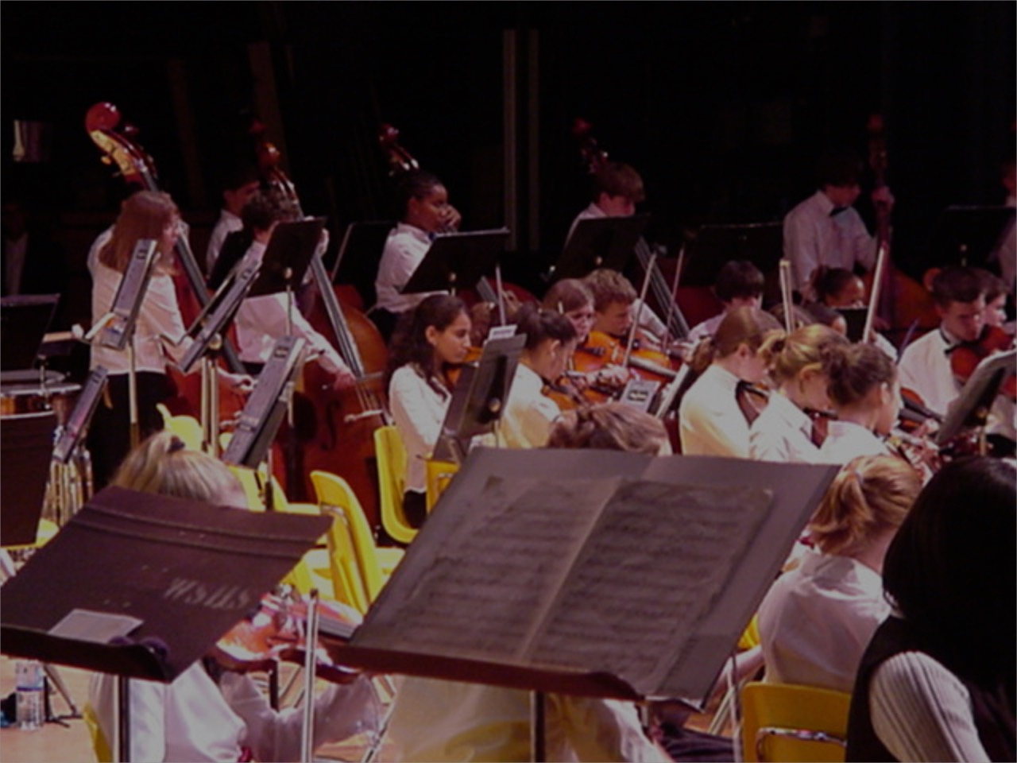
Now Prepare This! How to Tackle Orchestra Assessment
Michael Trowbridge, Retired Orchestra Director
Prince William County, Virginia - Public Schools
Co-author of Measures of Success for String Orchestra pub. FJH
mtrowbridgebass@gmail.com

Slide 2
Trow’s Basic Rules for Assessment
Read the “rules”
Check “the” list
Buy early
Correct arrangement?
The right fit for your orchestra
Yeah … the kids like it, but …
I love this piece, but …

Slide 3
Trow’s Basic rules continued...
No Mozart
No Mendelssohn String Symphonies
No Fugues
Not all year long
All year long
Trading places

Slide 4
Yikes even more of Trow’s rules!
The final say
Not the time to “try” something “new”
Worth the time
Don’t wait for the details

Slide 5
Preparing Music for Assessment
Start in September
“The middle section”
Invite others in
Recordings are your best friend
One position extended scales
Share the music
Move ‘em around

Slide 6
Prep continued…
Turn things around
Send your 1st chairs “out”
After school
Help the bass player
Keep it short
Why did you play

Slide 7
Selecting Music
Started years ago
Read the comments
Break it down
Middle section
Music selection form

Slide 8
The Pre-Assessment Concert
The best prep
Two weeks
Fix it
Get on stage
Invite your friends
Get an adjudicator(s)

Slide 9
Sight Reading
    Read the rules
    Sight read all year long
    Talk through the piece
    Students chip in
    Practice the routine

Slide 10
Sight reading continued...
“A Treasury of Scales”
Rhythm books
Method books
Move ‘em around
Cue your students

Slide 11
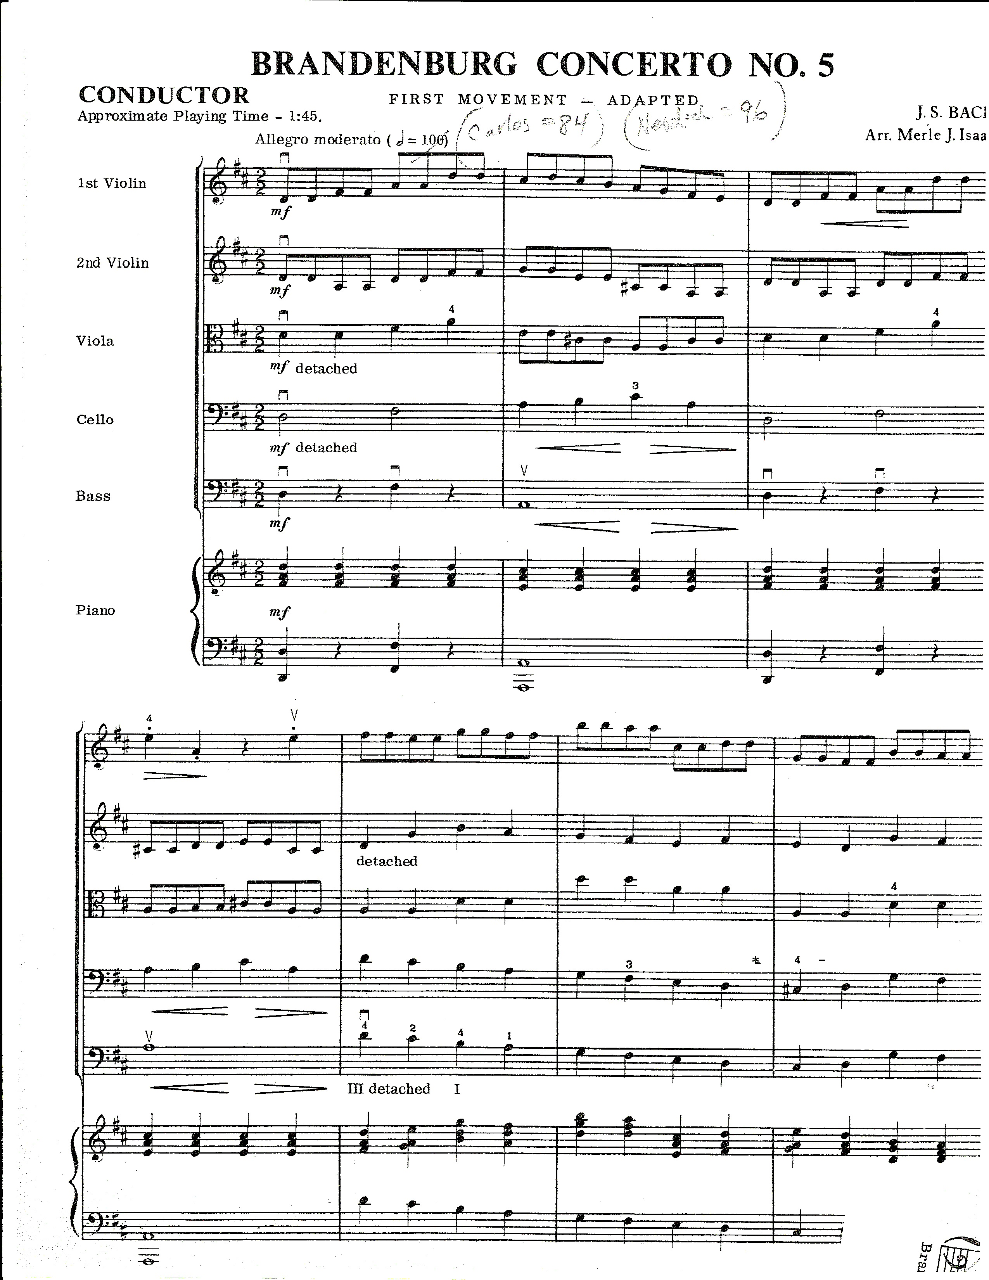
An inexperienced teacher sees this….

Slide 12
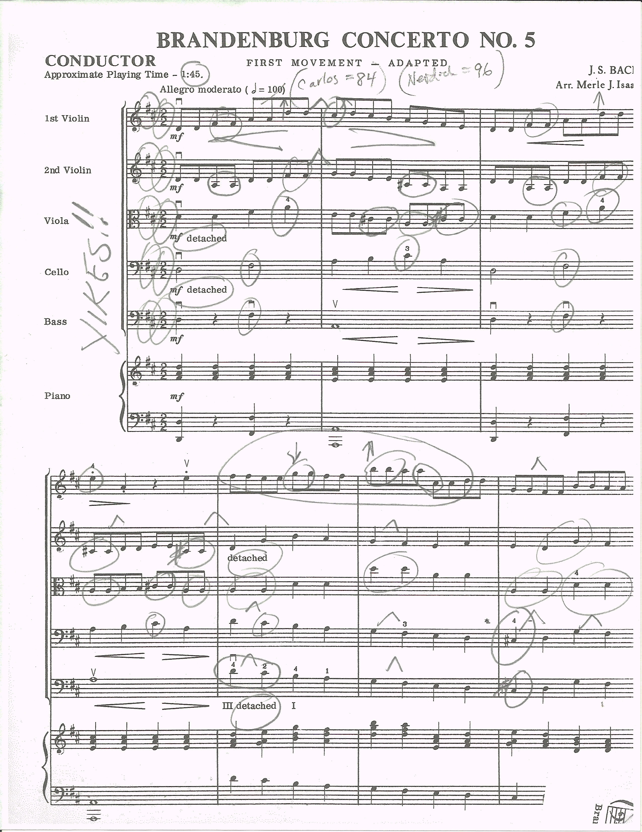
An experienced teacher sees…

Slide 13
The Warm Up
Successful
Comfortable
Done after the first note
Bach
Focus on tone and pitch

Slide 14
The Warm Up - continued
Shorter piece
Less time

Slide 15
Last thoughts ….
Use the entire year to prep
Use recordings
Kids want to play
Don’t worry……. It’s only assessment!

Slide 16
Contact info
Down load Power Point file of this session and notes from:
mtrowmusic.com
mtrowbridgebass@gmail.com

